Slide 1
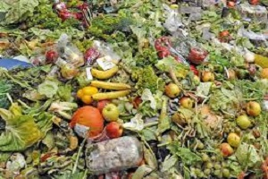
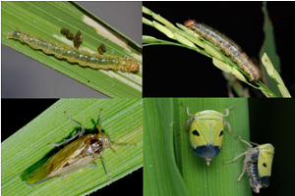
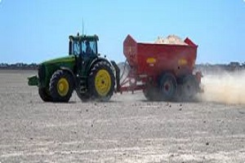
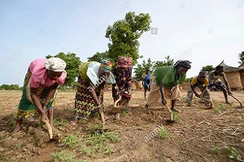
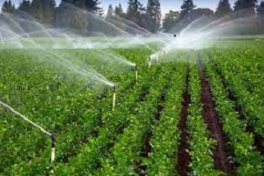
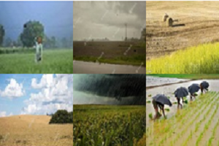
Decision Support System For Agriculture
Area
Food Waste Control
Pests Control
Soil-Sensitive Fields
Agricultural Production Processes
Water Resources Management
Climate Change Adaptation

Slide 2
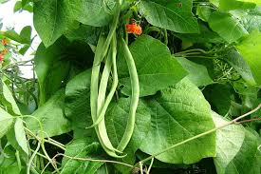
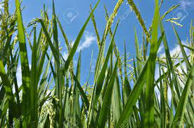
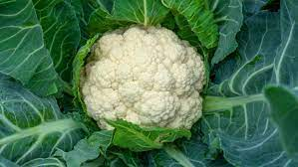
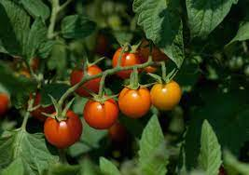
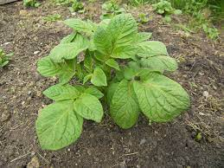
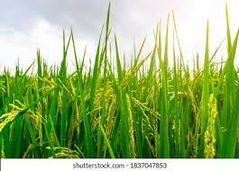
Decision Support System For Agriculture
Bean
Paddy
Cauliflower
Tomato
Potato
Paddy

Slide 3
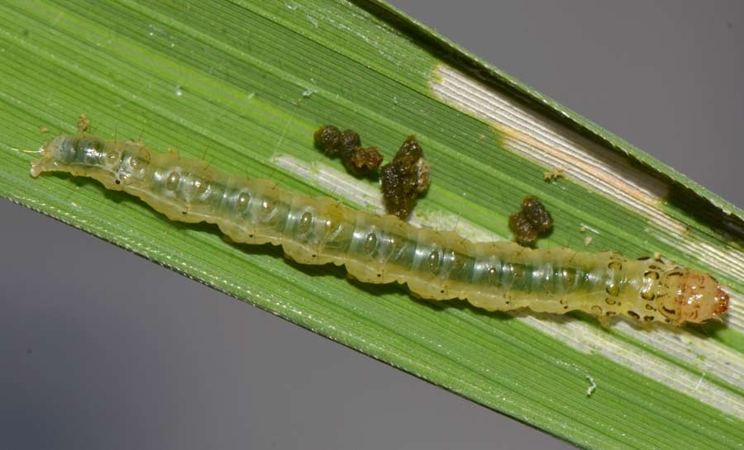
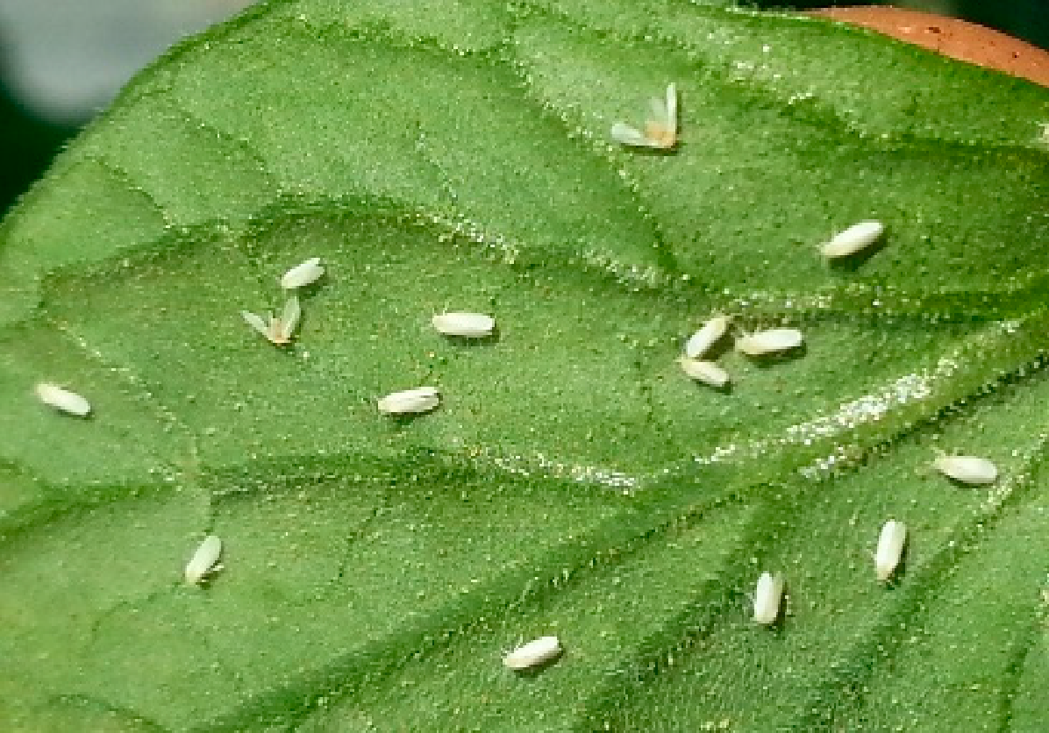
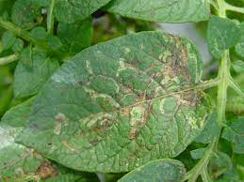
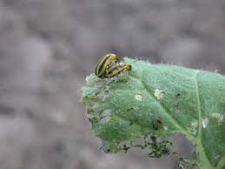
Pest Control
Paddy
Tomato
Potato
Watermelon

Slide 4


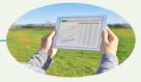

Purpose of The Research
Provide automated system to detect pest
to analyze the data efficiently, to get proper decision, minimize cost, increase the crop
Motivation
Saturn

Slide 5
Number -1
Existing Work
A novel decision support system for agriculture and farming
Data mining based
API for existing FMIS.
Web user interface (UI)
Case study: pests in orchards and fields
Kukar, Matjaž, Petar Vračar, Domen Košir, Darko Pevec, and Zoran Bosnić. "AgroDSS: A decision support system for agriculture and farming." Computers and Electronics in Agriculture 161 (2019): 260-271.

Slide 6
Number -2
Identify the pest that is present in the field.
To classify the pest, they used a microprocessor
Agnihotri, Vivek. "Machine Learning based Pest Identification in Paddy Plants." In 2019 3rd International conference on Electronics, Communication and Aerospace Technology (ICECA), pp. 246-250. IEEE, 2019.

Slide 7
Number -3
And can efficiently deal with different illumination conditions, the size of objects, and background variations, etc.
They proposed a deep-learning-based(Real-Time) approach to detect diseases and pests in tomato plants.
Technique Faster R-CNN, R-FCN, and Single Shot Multibox Detector.
The system is able to identify the infection status and location in the plant.
Also their system can find out the possibility that a plant can be simultaneously affected by more than one disease or pest in the same sample.
Fuentes, Alvaro, Sook Yoon, Sang Cheol Kim, and Dong Sun Park. "A robust deep-learning-based detector for real-time tomato plant diseases and pests recognition." Sensors 17, no. 9 (2017): 2022.

Slide 8
Analyze the Previous Work
Analyze the previous work, we found some issue
Number 1
Number 2
Number 3
Number 4
Different countries are situated in different locations with different environments in the world
As a result, their proposed decision support system is not proper for our country
Technique issue ( advance or old )
System issue (rule-based or automated )

Slide 9
Number 1
Different countries are situated in different locations with different environments in the world

Slide 10
Expected Dataset Format
image
csv

Slide 11
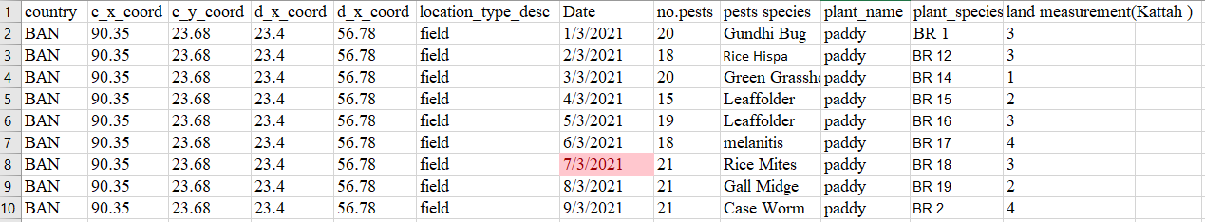
Dataset Format (CSV)

Slide 12
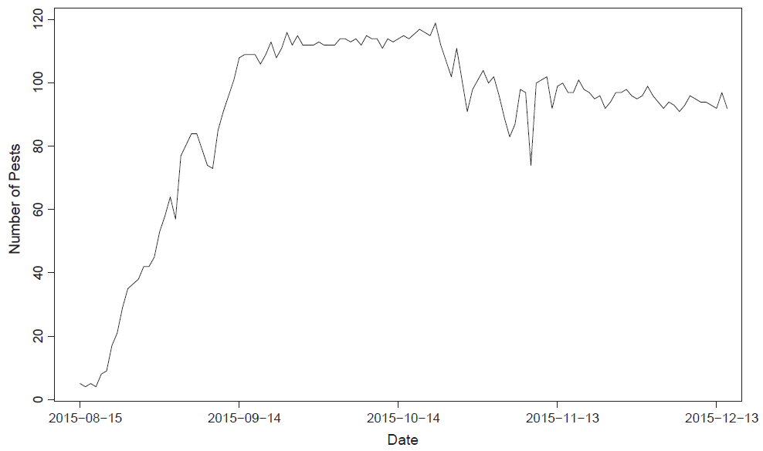
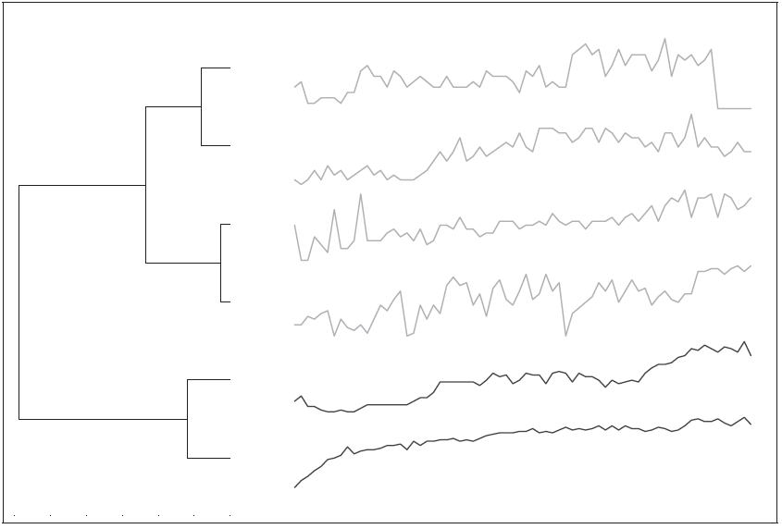
DECISION
Fig. Pest in a single location
Fig. Different groups of pest species.

Slide 13
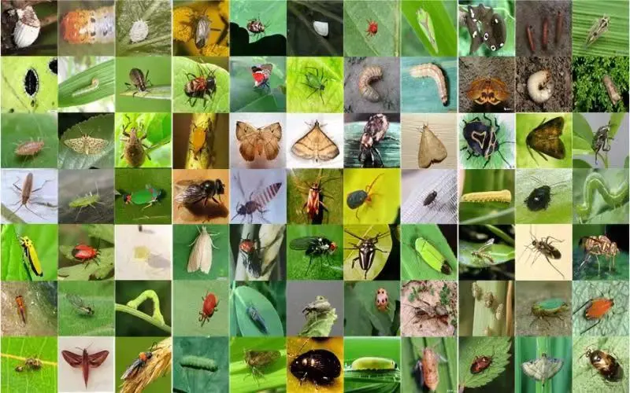
Dataset Format (image)

Slide 14
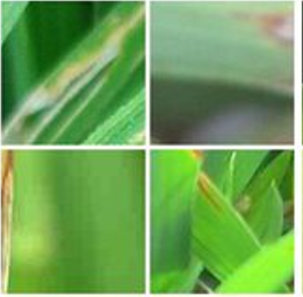
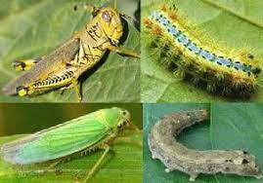
DECISION
Fig. No pest
Fig. Pest
এখানে আক্রান্ত পাতার ছবি হবে

Slide 15
Proposed Method
Data
Decision Making
Data Preprocessing
Data Visualize
Result
Parameter Tuning
Train Test Split
Feature Extraction
Modeling

